Slide 1


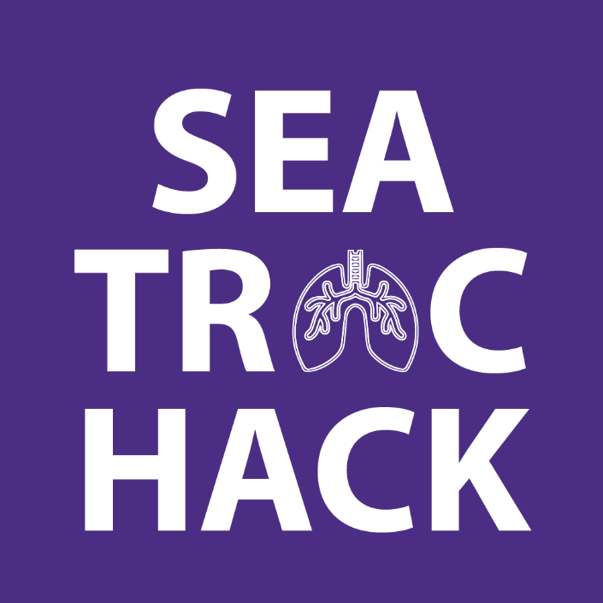
TB Drug Development and Clinical Trials TB Hackday, February 11, 2026
Patrick Phillips, PhD
UCTRAC • UCSF Center for Tuberculosis
Patrick.Phillips@ucsf.edu

Slide 2
Outline
What data will I get to use?
Why is this important?
Can my hacking have impact?

Slide 3
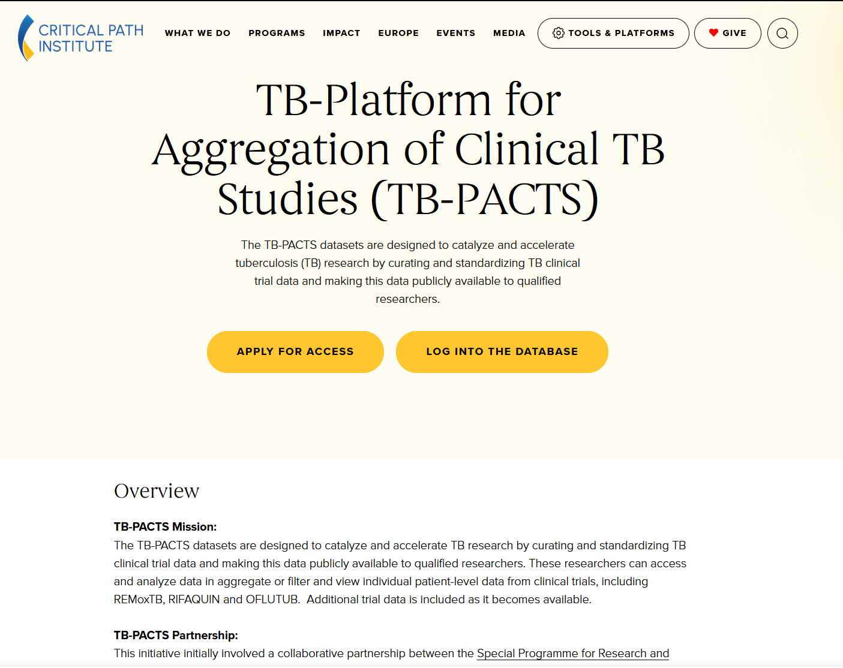
What data will I get to use?

Slide 4
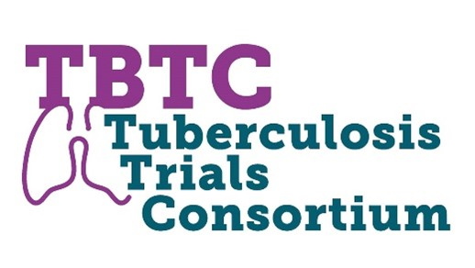



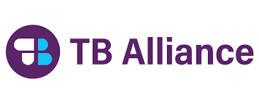

TB-PACTS Data Repository
Freely available
Request access here: https://c-path.org/tools-platforms/tb-pacts/
33 trials
27912 participants
50+ treatment regimens

Slide 5
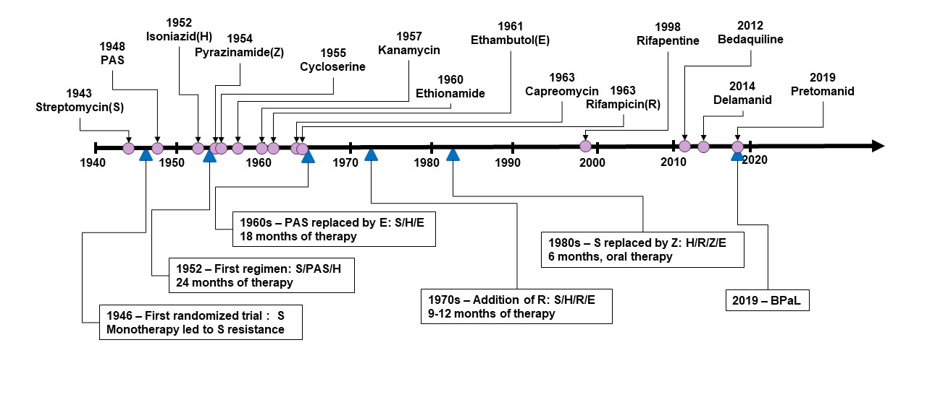
TB Alliance, https://www.tballiance.org/from-drugs-to-regimens-transforming-tb-drug-development/

Slide 6
Wave 1. First ever treatment for TB
Wave 1a. Combination regimen development
Wave 2. First new TB drugs for decades
Wave 2a. Combination regimen development
TB Alliance, https://www.tballiance.org/from-drugs-to-regimens-transforming-tb-drug-development/
With Thanks to Kelly Dooley for Wave Framework

Slide 7
Wave 1. First ever treatment for TB
Wave 1a. Combination regimen development
Wave 2. First new TB drugs for decades
Wave 2a. Combination regimen development
TB-PACTS Data
TB Alliance, https://www.tballiance.org/from-drugs-to-regimens-transforming-tb-drug-development/
With Thanks to Kelly Dooley for Wave Framework

Slide 8
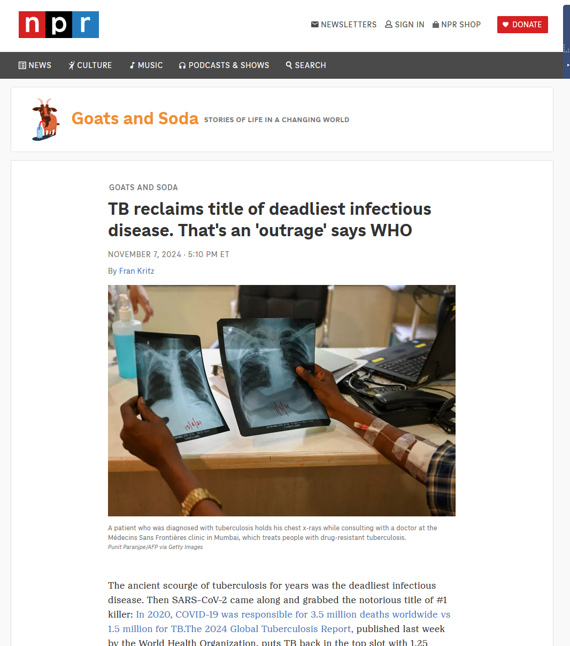
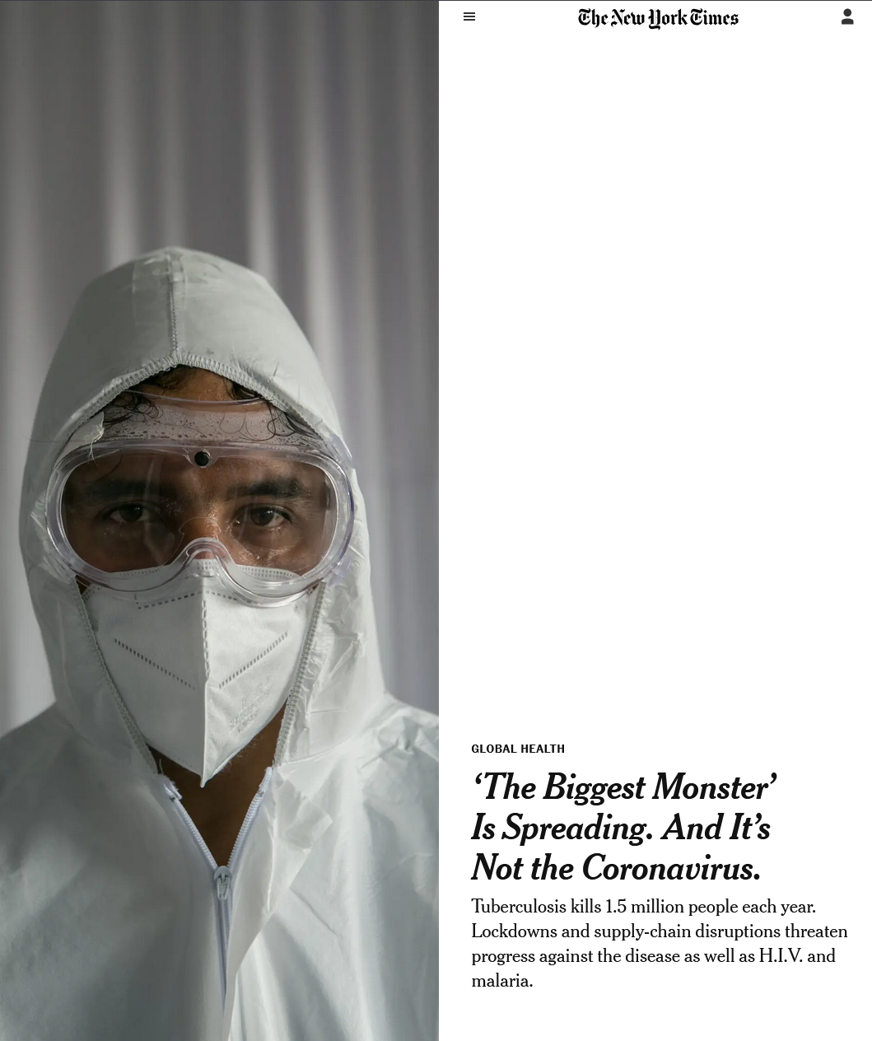
Why is this important?

Slide 9
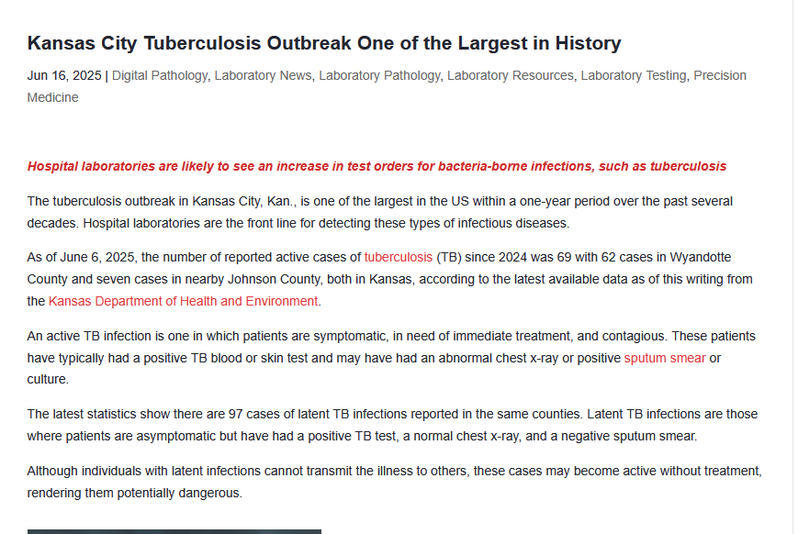
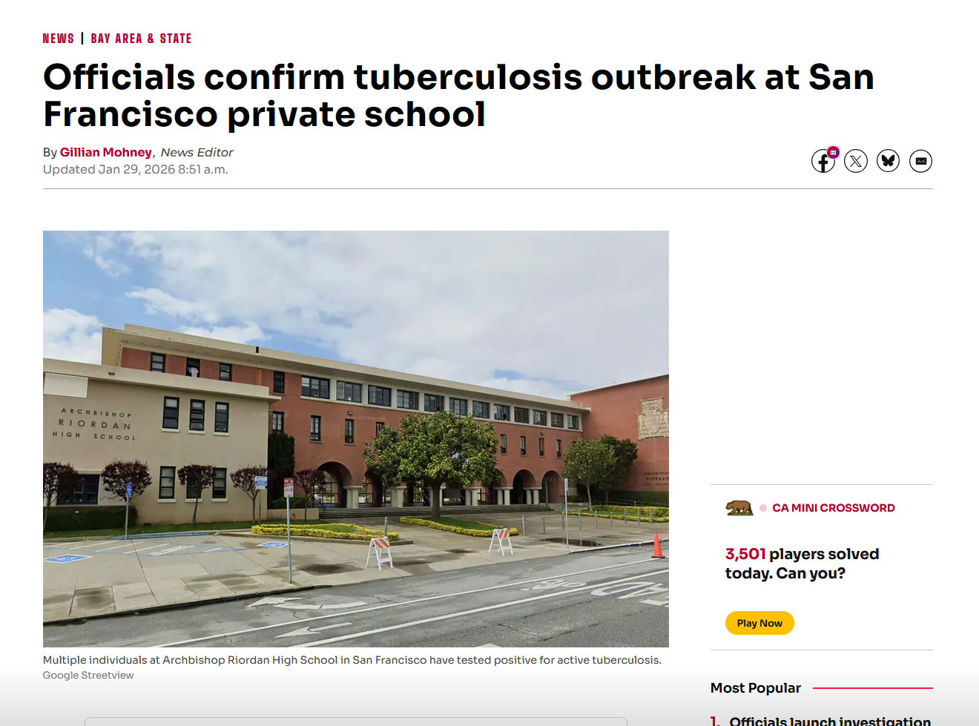
Why is this important?

Slide 10
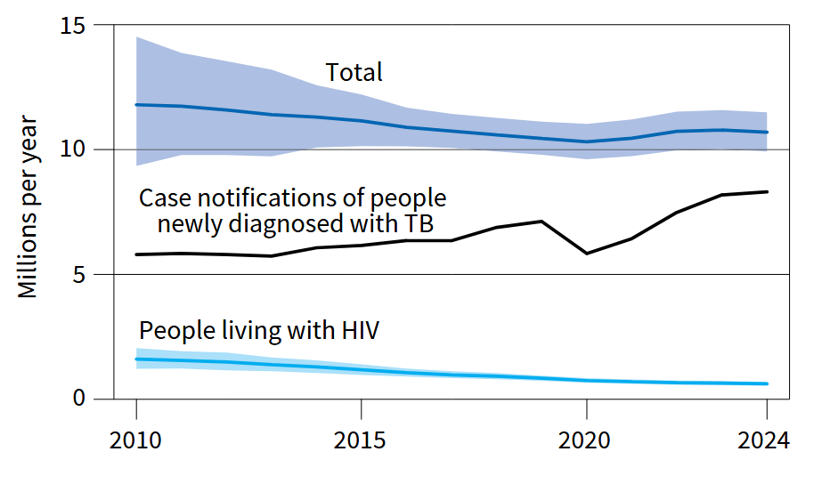
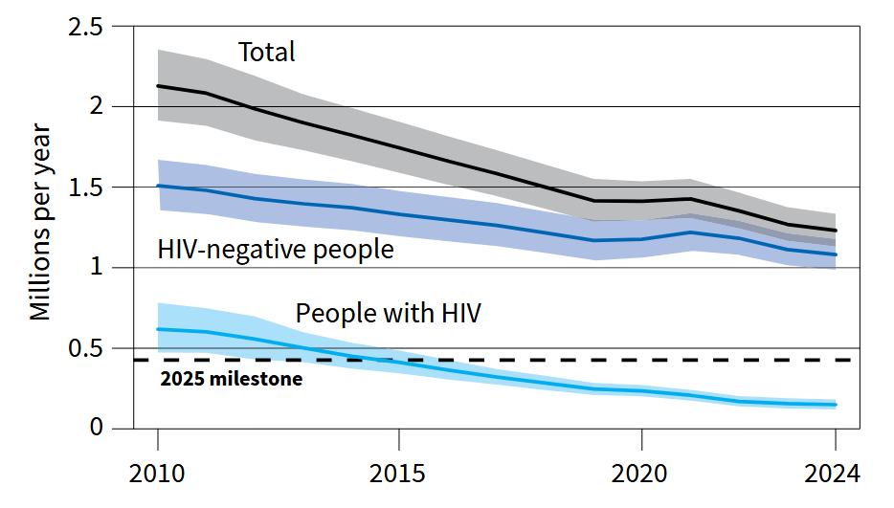
Why is this important?
10.7m new cases
1.23m deaths
World Health Organization. Global Tuberculosis Report 2025. Geneva: World Health Organization; 2025.

Slide 11
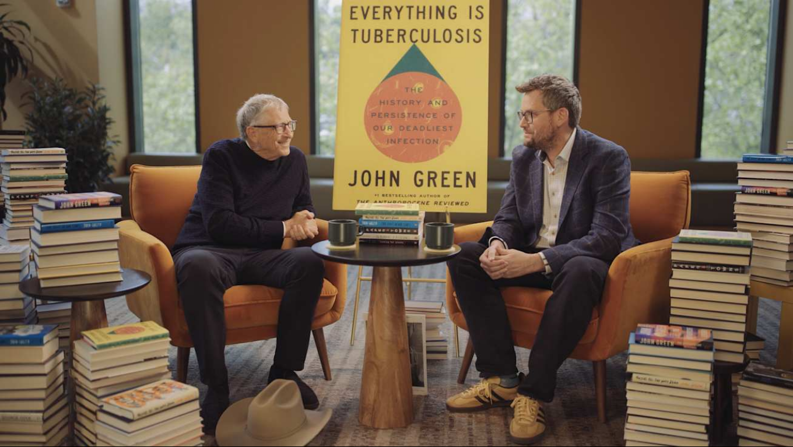
Why is this important?
https://www.gatesnotes.com/books/science/reader/everything-is-tuberculosis

Slide 12
Can my hacking have impact?

Slide 13
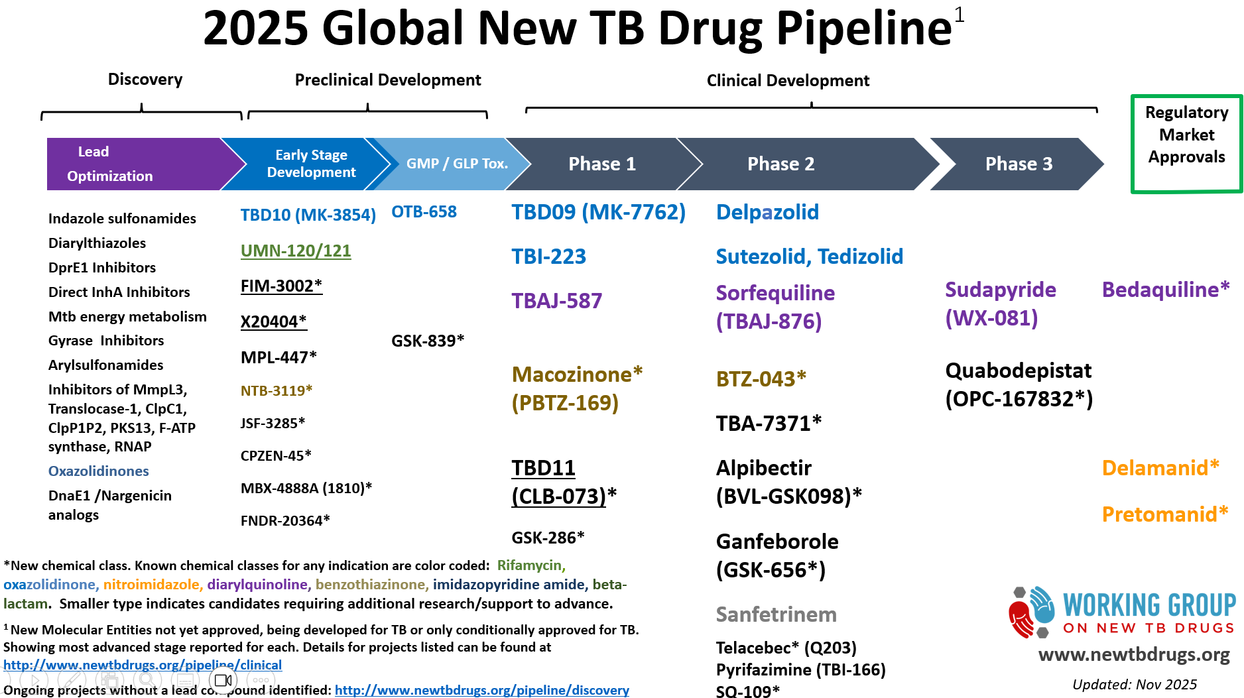
Wave 3. Resurgence in TB drug development

Slide 14
tb.ucsf.edu

